Slide 1
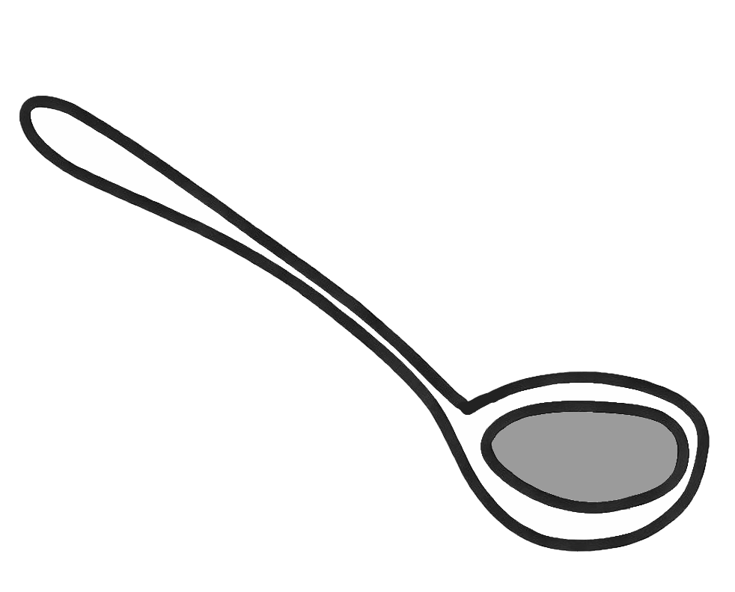
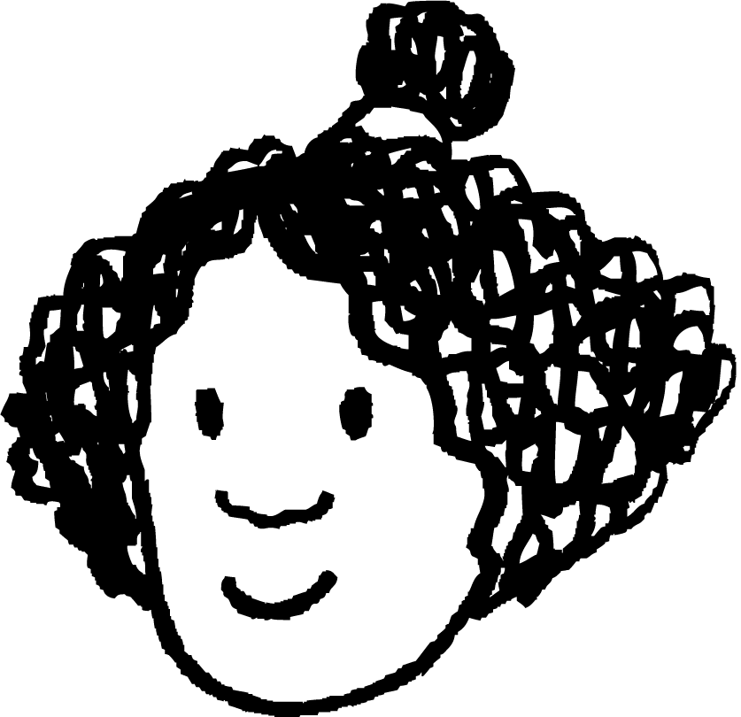
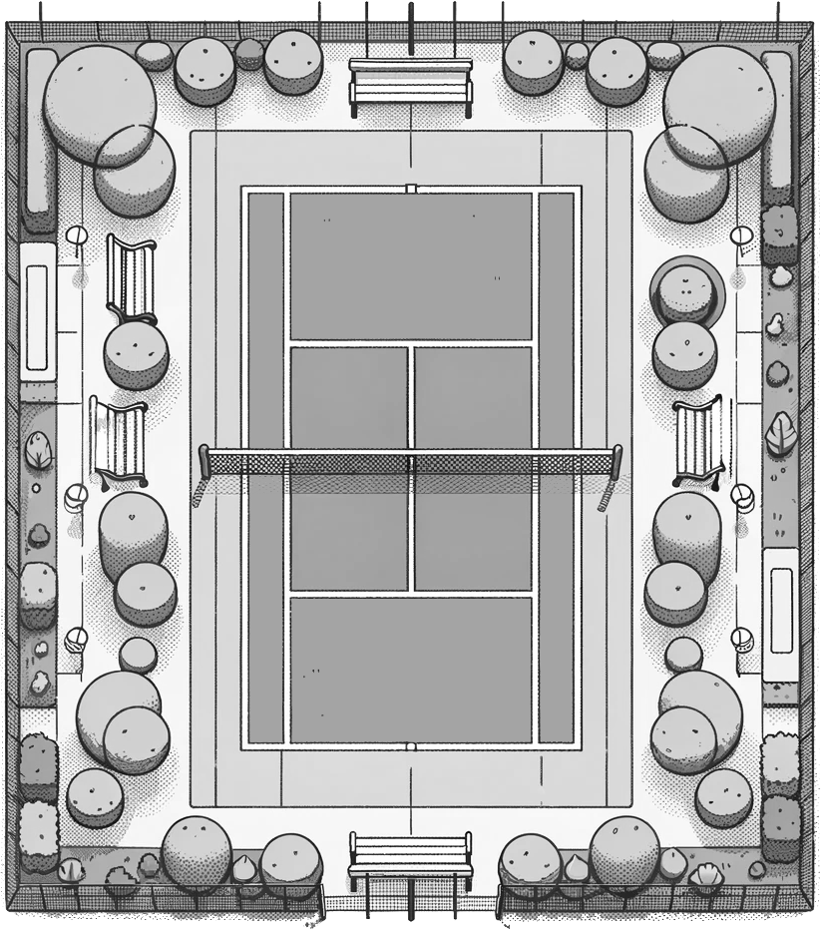


Pythagoras’ theorem in context
Task A: Contexts modelled by right-angled triangles
1) For this ladle to be usable with the saucepan, it has to be long enough that it won’t sink completely into the saucepan.
The saucepan is 20 cm tall and has a maximum base width of 30 cm.
a) The right-angled triangle models the saucepan. Label the saucepan and the right-angled triangle with the appropriate lengths.
b) Using Pythagoras’ theorem, explain whether the ladle is long enough to be used with this saucepan.
saucepan
ladle
20 cm
20 cm
36 cm
35 cm
30 cm
30 cm
The ladle is too short, at 35 cm.
This is because the maximum distance inside the saucepan is the diagonal length of 36 cm, and so the ladle can sink completely into the saucepan.
Izzy
2) Izzy is practicing her backhand shots. She can hit a backhand shot 28 metres.
Sofia and Laura stand at different corners of the court.
I
24 m
a) Model this context onto this right-angled triangle, labelling any relevant distances given in the context.
26.4 m
24 m
b) Explain whether Izzy’s backhand shot can reach Sofia.
S
11 m
L
11 m
Laura
It can, as Izzy’s shot of 28 m is longer than the 24 m between her and Sofia.
Sofia
c) Using Pythagoras’ theorem, explain whether Izzy’s backhand shot can reach Laura.
Using Pythagoras’ theorem, the distance between Izzy and Laura is 26.4 m. Therefore, Izzy’s 28 m shot can reach Laura.

Slide 2

Pythagoras’ theorem in context
3) A train conductor uses a 256 cm long access ramp to help passengers board a maglev train.
The step to board the train is 43 cm higher than the platform the passengers are waiting on.
How far onto the platform will the access ramp reach (to 1 d.p.)?
train
access ramp
platform
train
Task B: Analysing and evaluating modelled contexts
1) Radio towers must be at most 3000 m apart from each other in order for the radio signal to be broadcast to the local area.
Radio tower B is 1900 m north of radio tower A.
And radio tower C is 2400 m west of radio tower A.
a) Model the distances between all three radio towers on this right-angled triangle, labelling each vertex A, B, or C to represent the three towers.
b) Radio tower A breaks down. Are radio towers B and C close enough to each other for the radio signal to still be broadcast? Explain how you know.
B
3061 m
1900 m
C
A
2400 m
The radio signal will be lost, as the shortest distance from radio tower B to radio tower C is over 3000 m, at 3061 m.

Slide 3
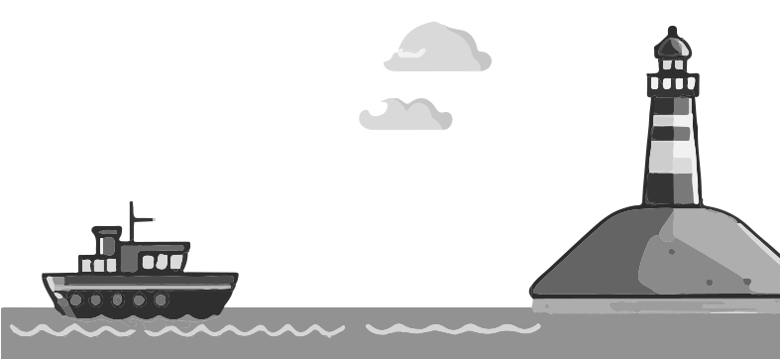
Pythagoras’ theorem in context
2) A lighthouse is 50 metres tall, and the light from it travels 130 metres to reach the boat.
The captain of the boat confidently declares:
“we are 120 metres away from the shore”.
Explain why the captain might be wrong.
You may reference assumptions made by the captain that are incorrect.
distance to lighthouse
distance to shore
From the right-angle triangle model of the lighthouse and boat, 120 m is correct. So why is he wrong?
130 m
The shore is horizontally closer to the boat than the lighthouse is.
50 m
The height of the lighthouse isn’t the total vertical distance to sea level. So, the captain hasn’t factored in that extra vertical distance.
120 m
3) A window cleaner needs to reach a window that is 412 cm above ground. This is safe to do if the horizontal distance from the wall to the foot of the ladder is a quarter of the height the ladder needs to reach.
a) Model this situation on this right-angled triangle, labelling any known lengths and which side of the triangle is modelling the ladder.
424.68 cm
distance ladder needs to reach
b) To what length should the window cleaner set their ladder?
c) What assumptions are you making about this context?
412 cm
height to window
The distance the ladder needs to reach is 424.68 cm.
Therefore, the window cleaner needs to set the ladder to 425 cm.
103 cm
Examples include:
The wall is perpendicular to the floor
The ground isn’t sloped
The ladder doesn’t bend when the window cleaner is on it

Slide 4
Pythagoras’ theorem in context
4) A phone mast that is 15 m in height is supported by a 24 m long cable that is tied to the ground with a hook.
Two lights are attached: one at the top of the phone mast, and the other at the hook, to reduce the risk of people walking into it at night time.
In order for the lights to work, a battery generator is attached to the base of the phone mast, and needs to be connected to both lights by an electrical wire.
a) Is a 35 metre long reel of electrical wire enough to connect the battery to both lights?
A 35 metre long reel of electrical wire is long enough.
This is because you need 15 m of wire to connect to the light at the top of the mast, and 18.7 m to connect to the light at the hook.
15 m + 18.7 m = 33.7 m, which is less than 35 m.
top of mast and light
24 m
15 m
hook and light
18.7 m
battery
b) What assumptions have you made about this context in part a)?
Possible answers could include:
The phone mast is perfectly vertical, and so is perpendicular to the ground.
The cable that is modelled by the hypotenuse of the triangle is perfectly straight, and doesn’t bend or dip.
The ground is perfectly horizontal, and doesn’t change its gradient at any point between the hook and the mast.
Mathematics in Education and Industry.

